Slide 1


Isolating Wide-Area Network Faults with Baywatch
Colin Scott
With Professor Ethan Katz-Bassett, Dave Choffnes, Italo Cunha,
Arvind Krishnamurthy, and Tom Anderson

Slide 2
A Quick Survey
Raise your hand if you used the Internet / email:
…since you got to this room?
…in the last hour?
…today?
Notes:
XXX
At this point, I’m going to assume anyone with hand down is too busy checking email to have heard the question
My point is that we all depend on the Internet

Slide 3
We Need the Internet to Be Reliable
We increasingly depend on the Internet:
Yesterday: Email, web browsing, e-commerce
Today: Skype, Google Docs, NetFlix
Tomorrow: Thin clients + cloud, traffic control, outpatient medical monitoring,…
So, we expect it to operate reliably:
High availability
Good performance
Does it achieve these goals?
Notes:
XXX?
Traditional apps like email and web browsing. E-commerce sites rely on the Internet’s reliable operation for their business
Now, we use to access data and apps in the cloud, to watch movies, and to talk on the phone. We want our cloud data to be reliably available, and we want our movies and phone calls to be smooth
Have to hang up multiple times and retry call
We’re moving towards a world where we’re much more dependent on the Internet
Future: most apps are in the cloud, most communication is over the Internet, want to run critical services
For these apps, we have to be able to rely on the Internet
Are we ready for that?
I’m going to show you that the current answer is no, but that we can take concrete steps towards improving it
What’s the current situation?

Slide 4
Many outages and most are partial
Approx 90% are partial
Number of VPs
Notes:
"holy shit, EC2, a central piece of infrastructure as everything moves into the cloud, has a lot of outages"

Slide 5
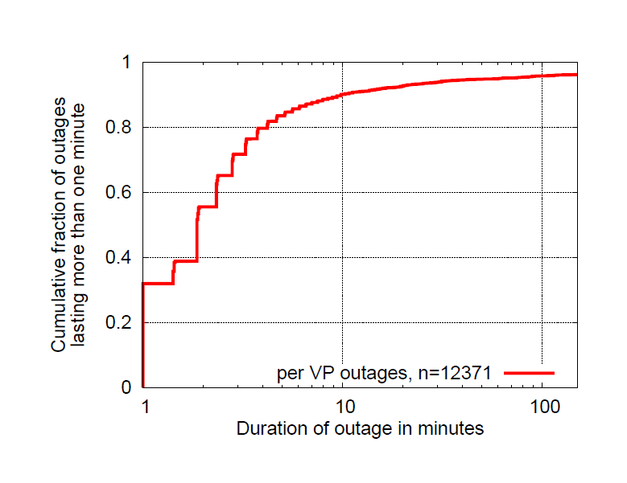
And can be surprisingly long-lasting
Approx 10% last 10 minutes or longer
Notes:
US-WEST, US-EAST, EU-WEST, Singapore
sending pings to 250 targets from the top 50 ISPs
ranked according to UCLA's topology data
one measurement round every 60 seconds

Slide 6
But where are the outages?
Can’t fix a problem if you don’t know where
State of the art: traceroute
Only tells part of the story
Even with control of source and destination
Especially without control of destination
Notes:
i would give an example here of why traceroute is not enough, that it shows the same thing for forward vs reverse, that it can point out the wrong place. if you wanted, you could also quote an outages "help! what's going on?" type post.

Slide 7
Example confusion (12/16/10)
“It seems traffic attempting to pass through Level3's network in the Washington, DC area is getting lost in the abyss. Here's a trace from VZ residential FIOS to www.level3.com:” – Outages.org list
User 1 1 Wireless_Broadband_Router.home [192.168.3.254] 2 L100.BLTMMD-VFTTP-40.verizon-gni.net [96.244.79.1] 3 G10-0-1-440.BLTMMD-LCR-04.verizon-gni.net [130.81.110.158] 4 so-2-0-0-0.PHIL-BB-RTR2.verizon-gni.net [130.81.28.82] 5 so-7-1-0-0.RES-BB-RTR2.verizon-gni.net [130.81.19.106] 6 0.ae2.BR2.IAD8.ALTER.NET [152.63.34.73] 7 ae7.edge1.washingtondc4.level3.net [4.68.62.137] 8 vlan80.csw3.Washington1.Level3.net [4.69.149.190] 9 ae-92-92.ebr2.Washington1.Level3.net [4.69.134.157] 10 * * * Request timed out.
User 1: Broken link is in DC

Slide 8
Example confusion (12/16/10)
“It seems traffic attempting to pass through Level3's network in the Washington, DC area is getting lost in the abyss. Here's a trace from VZ residential FIOS to www.level3.com:” – Outages.org list
User 2
1 192.168.1.1 (192.168.1.1)
2 l100.washdc-vfttp-47.verizon-gni.net (96.255.98.1)
3 g4-0-1-747.washdc-lcr-07.verizon-gni.net (130.81.59.152)
4 so-3-0-0-0.lcc1-res-bb-rtr1-re1.verizon-gni.net (130.81.29.0)
5 0.ae1.br1.iad8.alter.net (152.63.32.141)
6 ae6.edge1.washingtondc4.level3.net (4.68.62.133)
7 vlan90.csw4.washington1.level3.net (4.69.149.254)
8 ae-71-71.ebr1.washington1.level3.net (4.69.134.133)
9 ae-8-8.ebr1.washington12.level3.net (4.69.143.218)
10 ae-1-100.ebr2.washington12.level3.net (4.69.143.214)
11 ae-6-6.ebr2.chicago2.level3.net (4.69.148.146)
12 ae-1-100.ebr1.chicago2.level3.net (4.69.132.113)
13 ae-3-3.ebr2.denver1.level3.net (4.69.132.61)
14 ge-9-1.hsa1.denver1.level3.net (4.68.107.99)
15 4.68.94.27 (4.68.94.27)
16 4.68.94.33 (4.68.94.33)
17 * * *
User 1: Broken link is in DC
User 2: It’s in Denver?
Is this even the same problem?
What if it’s on the reverse path? (and paths aren’t symmetric)

Slide 9
System for wide-area failure isolation
Goal: Detect and isolate outages online
What kind of outages?
Long-lasting
Avoidable
High impact
What kind of isolation?
IP-link
How quickly?
Within seconds or small numbers of minutes
Notes:
Not fixing themselves
: requires path diversity, no stub Ases
: outages in PoPs affecting many paths

Slide 10
What we want out of isolation
Direction (forward or reverse)
Narrowly determine location (link or ASN)
Alternate working paths (facilitates remediation)
Online (allows for immediate action)
So, how do we accomplish this?

Slide 11

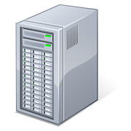
Detecting outages with pings
Ping?
Source
Target
Source

Slide 12

Detecting outages with pings
Source
Target
Source
Source

Slide 13
traceroute doesn’t work
TTL=1
Source
Target
Source

Slide 14
traceroute doesn’t work
R1
R1: Time Exceeded
S
Target

Slide 15
traceroute doesn’t work
R1
TTL=2
S
Target

Slide 16
traceroute doesn’t work
R1
R2
R2: Time Exceeded
S
Target

Slide 17
traceroute doesn’t work
R1
R2
R1
TTL=3
Target
S
Target
S

Slide 18
traceroute doesn’t work
R1
R2
R1
Target
S
Target
S
?

Slide 19
Spoofed traceroute ftw
S’
R1
R2
R1
Target
S
Target
S

Slide 20
Spoofed traceroute ftw
R2: Time Exceeded
S’
R1
R2
R1
Target
S
Target
S

Slide 21
Spoofed traceroute ftw
R3: Time Exceeded
S’
R1
R2
R3
R1
Target
S
Target
S

Slide 22
Spoofed traceroute ftw
R4: Time Exceeded
S’
R1
R2
R3
R1
R4
Target
S
Target
S

Slide 23
Spoofed traceroute ftw
Target: Pong
S’
R1
R2
R3
R1
R4
Target
S
Target
S

Slide 24
What now?
S’
R1
R2
R3
R1
R4
X
Target
S
Target
S
S

Slide 25
Measure working reverse paths
S’
S’
R2
R3
R1
R3
R1
R1
R1
R4
R4
Target
Target
Target
S
Target
S
S
S
S
S
X
OK, somewhere on R3’s reverse path
But where?

Slide 26
Historical path atlas
Each host traceroutes each target
VPs
Targets

Slide 27
Historical path atlas
Each host measures reverse paths
VPs
Targets

Slide 28
Ping historical hops
S’
R1
R2
R3
R1
R4
Target
S
Target
S
S

Slide 29
Ping historical hops
S’
R1
R2
R3
R1
R4
X
Target
S
Target
S
S

Slide 30
Putting it all together
Find spoofing VPs that reach target
Determine working direction (if any)
Forward: issue spoofed forward traceroute
Reverse: VPs spoof towards target as source, issue spoofed reverse traceroute
Failure cases
Forward-only: spoof traceroute
Reverse-only: reverse traceroute from each fwd hop, ping historical hops
Bi-directional: spoof traceroute

Slide 31
Results
Baywatch has been running for 4 months
12 geographically distributed VPs monitoring:
CloudFront PoPs (16)
Correlate with app-layer outages
Popular PoPs wrt # intersecting paths (83)
And targets on “other” side of PoPs (185)
PlanetLab hosts (76)
Ground-truth isolation

Slide 32
Does it work?
May 24th at 11:39pm, two vantage points identified
ae3-3.erb1.Chicago2.Level3.net as a suspected failure.
Outages.org:
“Saw issues routing through Chicago via Level3 starting around 11:05pm, cleared up about 11:43pm.”
Confirmed by other operators

Slide 33
Does it work?
In general, ground truth data is hard to obtain
Plan to:
Corroborate with NANOG
Post to Outages.org
Email individual operators

Slide 34
What did we find?
Detected ~22,000 partial outages. 778 filtered.
Baywatch was able to measure the full opposite direction in 63% of uni-directional ouatges
Identify possible alternate working paths for more than half of outages
Location (~2500 total)
PL/Mlab: 1241
Top 100: 1220
CloudFront: 38
Duration: Average is 453 seconds
Directionality
Forward: 860
Reverse: 130
Bi-directional: 439
The rest were indeterminate (different path, fixed by time of isolation, …)

Slide 35
Summary
System for wide-are failure isolation
Detection at fine granularity
Algorithm for isolation
Historical, rapidly refreshed path atlas
Spoofed probing to measure during outage
Pings to infer reachability

Slide 36
Questions?

Slide 37
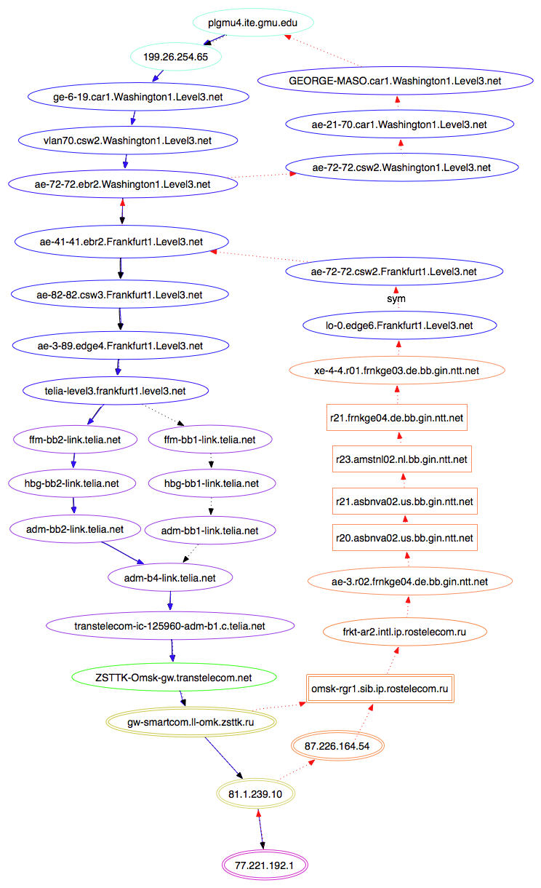

Slide 38
Reverse traceroutes
Reverse path info generally requires
IP options support along the path
Limited spoofing
A lot of trial and error

Slide 39
Simple (real) example
plgmu4.ite.gmu.edu to pl2.bit.uoit.ca
Normal traceroute
1. 199.26.254.65
2. 10.255.255.250
3. 192.70.138.121
4. 192.70.138.110
5. 216.24.186.86
6. 216.24.186.84
7. 216.24.184.46
8. * * *
9. * * *
10. * * *
11. * * *
12. * * *
Spoofed traceroute
1. 199.26.254.65
2. 10.255.255.250
3. 192.70.138.121
4. 192.70.138.110
5. 216.24.186.86
6. 216.24.186.84
7. 216.24.184.46
8. 205.189.32.229
9. 66.97.16.57
10. 66.97.23.238
11. pl2.bit.uoit.ca (205.211.183.4)

Slide 40
Outages happen.
They’re expensive, embarrassing and annoying
They take a long time to fix
Alert
Troubleshoot
Repair
Lack of good tools for wide-area isolation
Notes:
the thing that always strikes me (say, in talking to people at google / amazon / ms, or in reading outages, or talking to colin about his internship) is how much time they spend troubleshooting problems, bc they lack good tools.

